Slide 1

THIRD EYE FOR THE BLIND
Team Members
Taha Junaid [18BCD7072]
Mohd Taqiuddin [18BCN7050]
Darrain Saa-eyd [18BCN7009]
Shoaeb Nawab Shaik [18BEC7067]
P.Sai Teja [18MIS7109]
Chaitanya [18MIS7259]
Batch No : 180426
Guided by
Prof.Asish Kumar Dalai
Dept. of CSE

Slide 2
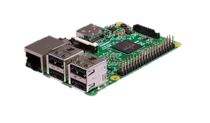
Agenda
Abstract
Module Identification
Equipment Identified
Time Line Chart
References

Slide 3
Abstract
The idea to make a blind person access all the benefits of his surroundings has lead us to work on this project. We aim to completely facilitate a visually impaired person in all sorts of possible ways.
For instance ,even though a specific language exists for them , the Braille script, it restricts their reading to the books printed in those characters. Reading any sort of English text printed literature, novels or any other sign boards, shop banners would amaze them.
Moreover, walking alone to unknown places has always been a scary task for them. But not now, as the AI installed in the module would give them walking directions to the nearest saloon or so.

Slide 4
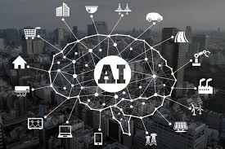
This AI can even set alarms and reminders to get their daily chores done on time.
And to avoid visitor surprizes and cut off the awkward moment to ask who the person is we aim to add a face recognition system to our module, so the presence of a known person is notified by the automated voice.

Slide 5
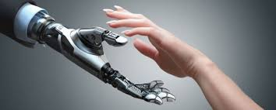
Module Identification
Text Reading: This feature will involve image processing This project has been built around Raspberry Pi processor board. It is controlling the peripherals like Camera, speaker and LCD which act as an interface between the system and the user. Optical Character Recognition or OCR is implemented in this project to recognize characters which are then read out by the system through a speaker. As shown in the project setup, the camera is mounted on a stand in such a position that if a paper is placed in between the area marked by angular braces, it captures a full view of the paper into the system. Also, when the camera takes the snapshot of the paper, it is ensured that there is good lighting conditions.
AI(Google Assistant):A Google Cloud Platform project, managed
by the Actions Console, gives your device access to the Google
Assistant API. The project tracks quota usage and gives you valuable
metrics for the requests made from your device.

Slide 6
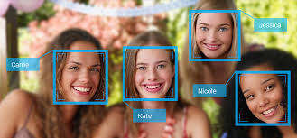
Face Recognition: To create a complete project on Face Recognition, we must work on 3 very distinct phases:
Face Detection and Data Gathering
Train the Recognizer
Face Recognition

Slide 7
Equipment Identified
S.No | Name of Equipment* | Quantity
1 | Raspberry Pi | 1
2. | Camera | 1
3. | Speaker | 1
4. | Mic | 1
These equipment are the ones as per the plan. May vary as we proceed with the project.

Slide 8
Timeline Chart
Delivery
Testing
Integration with IDE
Coding – Raspberry Pi(Python based)
Hardware Analysis
Pbm Identified
Literature Survey
Modules | Dec 1-4 Week | Jan 1st Week | Jan 2nd Week | Jan 2nd Week | 3rd &4th | Feb 1st Week | Feb 2nd Week | 3rd | 4th | March 1st week | March 2nd Week

Slide 9
References
1. https://www.raspberrypi.org/blog/learning-python-with-raspberry-pi/
2. https://www.hackster.io/Rjuarez7/raspberry-pi-3-face-detection-in-python-2-and-opencv-2-2b06bf
3. https://www.instructables.com/id/Google-Assistant-on-a-Raspberry-Pi/
4. https://www.irjet.net/archives/V5/i6/IRJET-V5I6306.pdf
5. https://www.hackster.io/mjrobot/real-time-face-recognition-an-end-to-end-project-a10826

